Slide 1
SNIP: Bridging Mathematical Symbolic and Numeric Realms with Unified Pre-trainning
Kazem Meidani, Parshin Shojaee, Chandan K. Reddy, Amir Barati Farimani
ICLR 2024
Yucong He
2024.11.19

Slide 2




Authors
Senior PhD candidate at Carnegie Mellon University.
Graduate research assistant in the Mechanical and Artificial Intelligence Lab (MAIL)
Was AI Scientist Research Intern in EA AI Lab
Language Models & AI for Science
Third-year PhD student in the Computer Science department at Virginia Tech
AI for Math & AI for Code
Russel V. Trader Associate Professor at Machine Learning
Courtesy Associate Professor at Mechanical/ Biomedical/ Chemical Engineering
Mechanical and Artificial Intelligence laboratory (MAIL)
Machine Learning and Natural Language Processing with applications to Healthcare, Software, Transportation, and E-commerce.
Amir Barati Farimani
Carnegie Mellon University
Notes:
Language Models: LLMs as Search Agents, LLMs for Code generation and Scientific Discovery, Multi-modal Pre-training for Math, Generative Language Models for symbolic expressions
AI for Science: Transformers and GNNs for Learning Physics, ML and Optimization for Scientific Discovery
3 Chandan K. Reddy 是弗吉尼亚理工大学计算机科学系的教授，也是桑加尼人工智能与数据分析中心（Sanghani Center for Artificial Intelligence and Data Analytics）的核心成员
4 斯坦福博士后
Amir Barati Farimani 是卡内基梅隆大学机械工程系的副教授，同时在生物医学工程、化学工程和机器学习等领域拥有兼职职位。他领导的机械与人工智能实验室（MAIL）主要研究将机器学习、数据科学和分子动力学模拟应用于健康和生物工程问题。

Slide 3
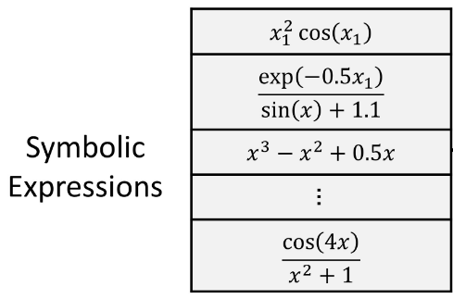
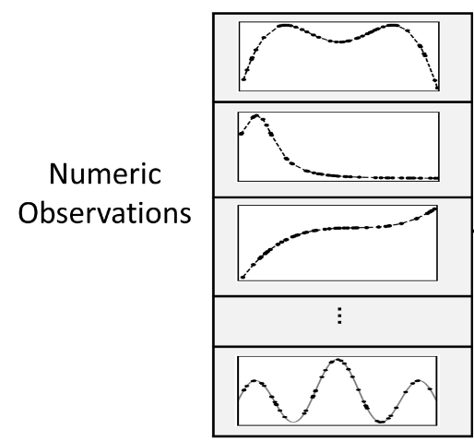
Introduction
Present Symbolic-Numeric Integrated Pre-training (SNIP) to connect the two often distinct worlds of symbolic mathematical expressions and their corresponding numeric manifestations.
It is a multi-modal pre-training, where models are trained to understand relationships across different modalities.

Slide 4
Contents
Pre-training model SNIP
numeric-to-symbolic equation generation task

Slide 5
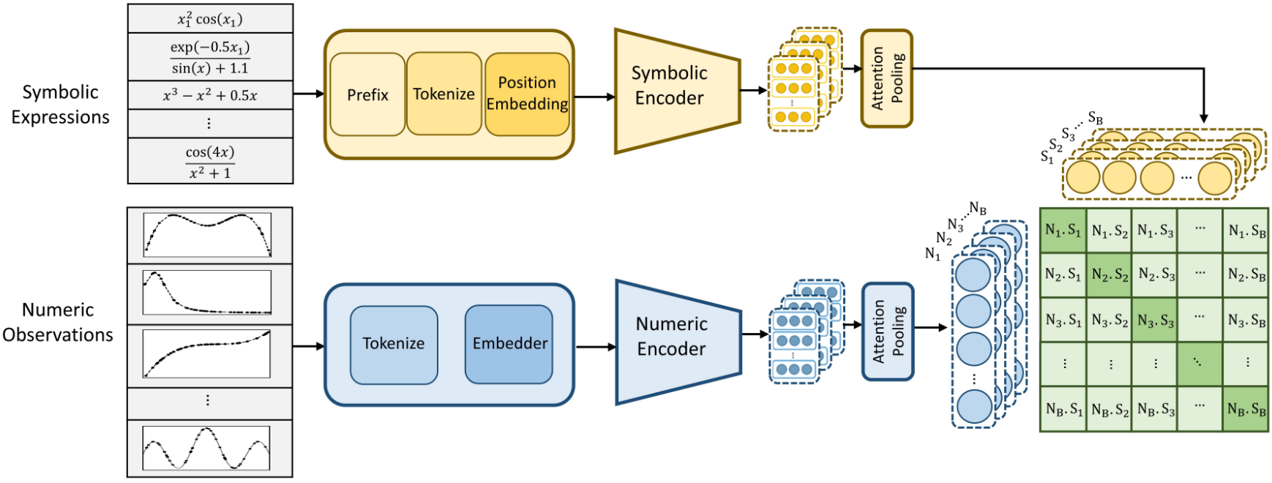
The SNIP Framework

Slide 6



Numeric encoder
1
three Tokens: sign, mantissa (0-9999 range), and exponent (E-100 to E100).
For instance, the number 5.432 is tokenized as [+, 5432, E-3].
Given a batch of N numeric input points (x, y) ∈ RD+1, each is represented by 3(D + 1) tokens.
2
This embedder maps each input point to a unique embedding space. The resulting embeddings, with dimension dem, are then fed into the encoder.
3
1
2
3
Numeric encoder: a multi-layer Transformer architecture.

Slide 7







Numeric encoder
2
Attention-based Distillation
1
Numeric encoder: a multi-layer Transformer architecture.
Let AV denote the attention weights
Wa ∈ Rde is a learnable weight matrix
The compact sequence-level representation ZV ,
is then obtained by: ZV = AV ·VLV .
l ranges from 1 to LV ,
LV signifies number of layers within the numeric encoder
1
2

Slide 8



Symbolic encoder
1
2
3
1
Mathematical expressions are tokenized by prefix order of their trees.
This process employs self-contained tokens to represent operators, variables, and integers
constants are encoded using the same representing, each with three tokens.
2
Symbolic encoder uses the same Transformers model.
3
Symbolic compact representation:
1
Tokenized expression:

Slide 9
The SNIP Framework

Slide 10
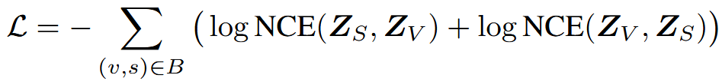
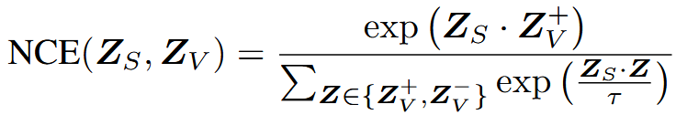
Unified pre-training objective
the contrastive losses on symbolic-to-numeric and numeric-to-symbolic similarities

Slide 11
The SNIP Framework

Slide 12
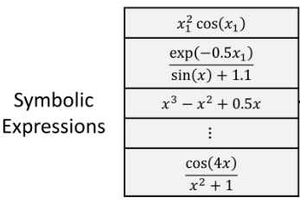
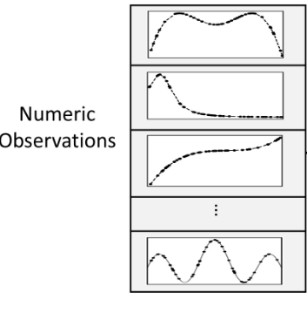
Pre-training data
Sampling of functions
y = f (x)
This process involves selecting an input dimension D, determining the number of binary operators, constructing binary trees, assigning variables to leaf nodes, inserting unary operators, and applying random affine transformations.
Sampling of datapoints
After generating a function, we sample N input points and find their corresponding target values. Our approach includes drawing inputs for each expression from various distributions, enhancing training diversity and normalization along each dimension. To emphasize on the function’s numeric behavior rather than the range of values, we also normalize the target values y between (0, 1).

Slide 13
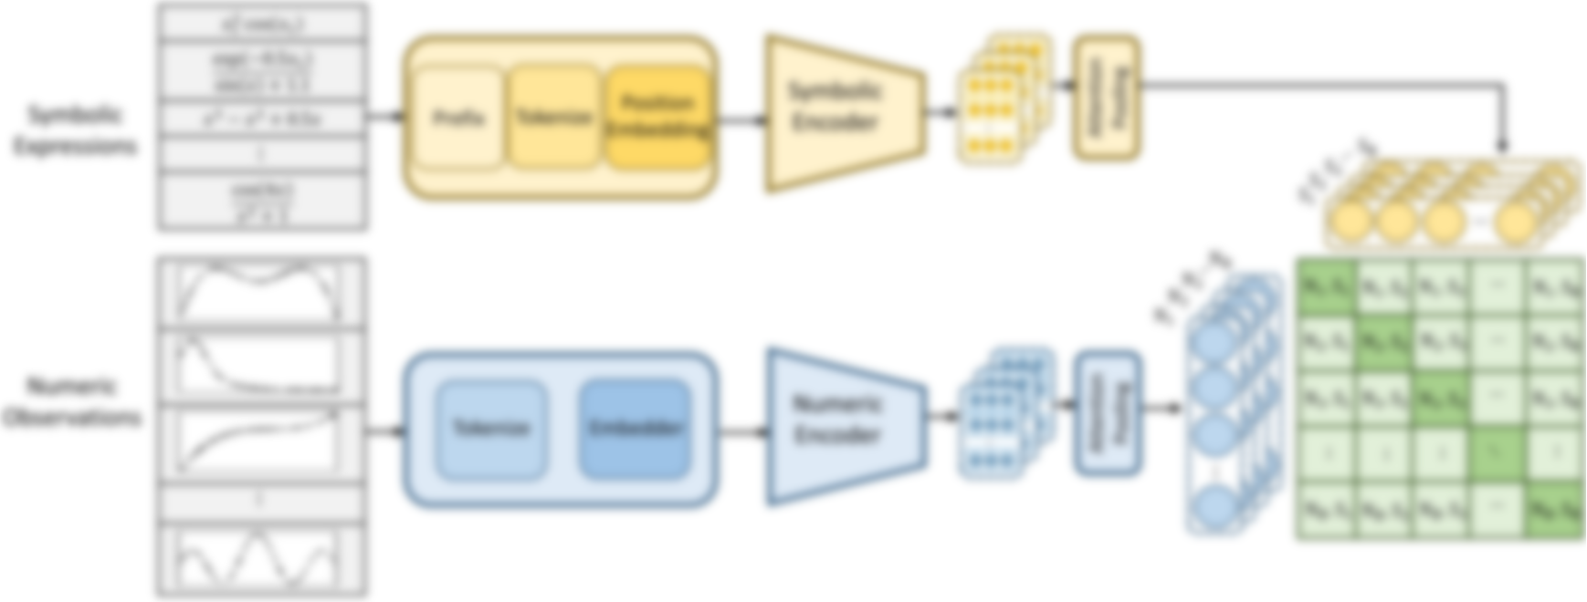
Property prediction
To assess property prediction on top of SNIP’s embeddings, we employ a predictor head that passes these embeddings through a single-hidden-layer MLP to yield the predicted values (Non-Convexity Ratio NCR, and Function Upwardness).
single-hidden-layer MLP
Mathematical Properties

Slide 14
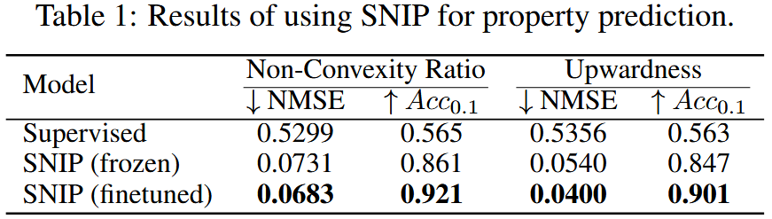
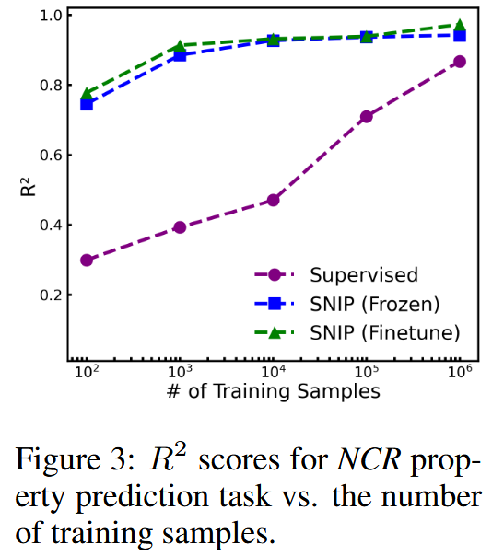
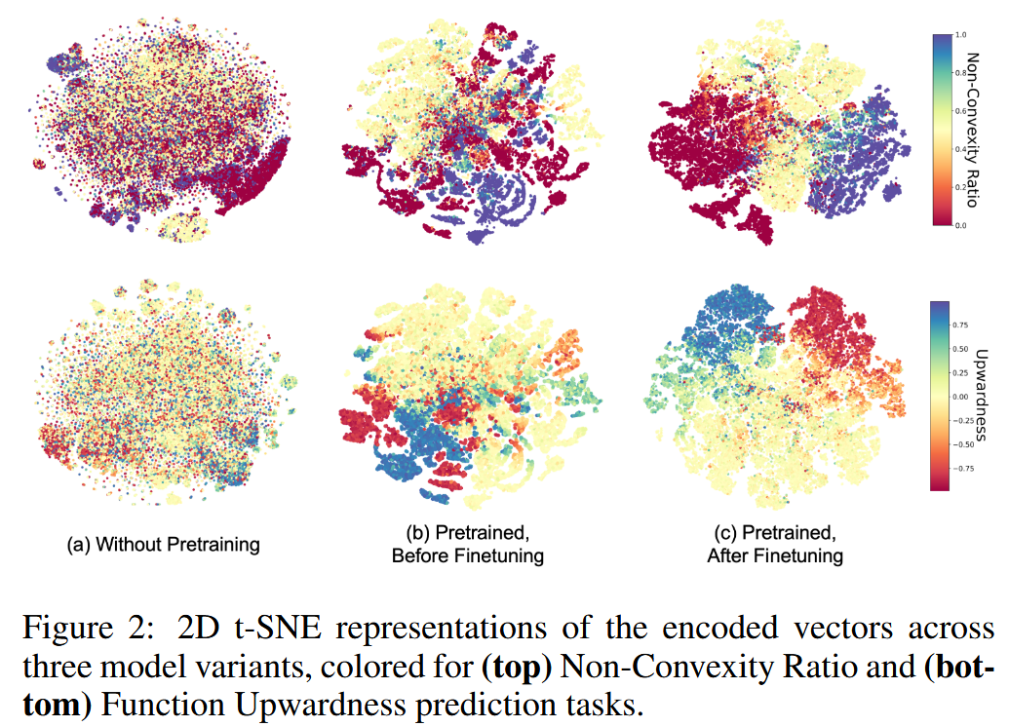
Property prediction
SNIP’s value lies in its flexibility: the pre-trained representations can be efficiently adapted to new tasks. These results emphasize SNIP’s superior generalization from limited data, underscoring the SNIP’s rich semantic encodings.

Slide 15
Symbolic regression: Equation discovery

Slide 16
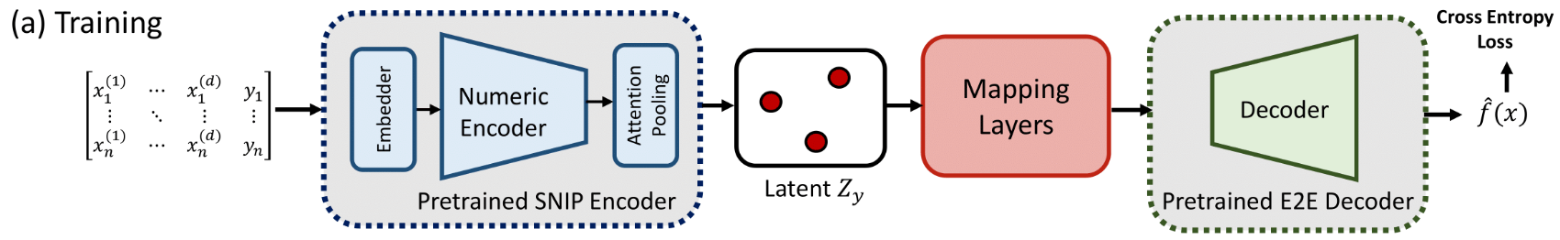





Training
a learnable Mapping Network gγ. , This module translates SNIP’s numeric embeddings ZV into a compatible input for DE2E .
This decoder is trained to map numeric encodings into symbolic expressions, aiming to minimize the divergence between the predicted fˆ and actual functions f .

Slide 17
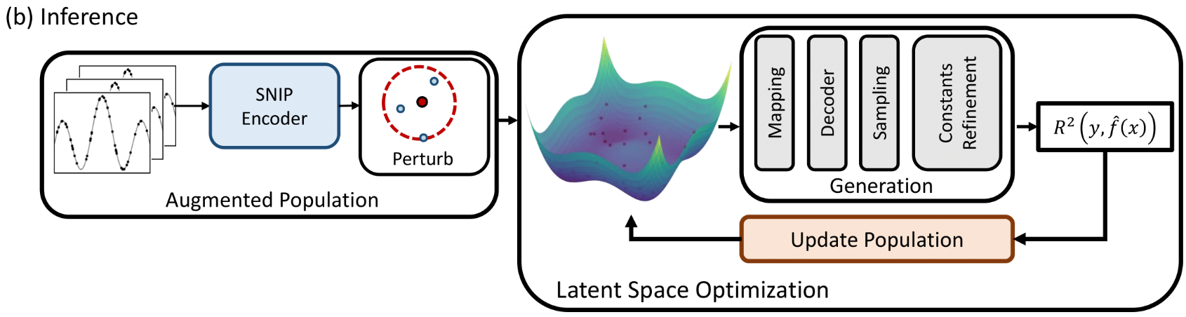




Inference
Initialize the search population by augmenting the given dataset into a partitioned population P = {P1, P2, P3}
P1 contains encodings from random sub-samples, with size n < N of the original data;
P2 includes encodings from sampled inputs with their target values y perturbed by random Gaussian noise (perturb and then encode);
P3 includes perturbed encodings from a fixed sampled data (encode and then perturb).
updates to the latent population are carried out using a gradient-free optimizer

Slide 18
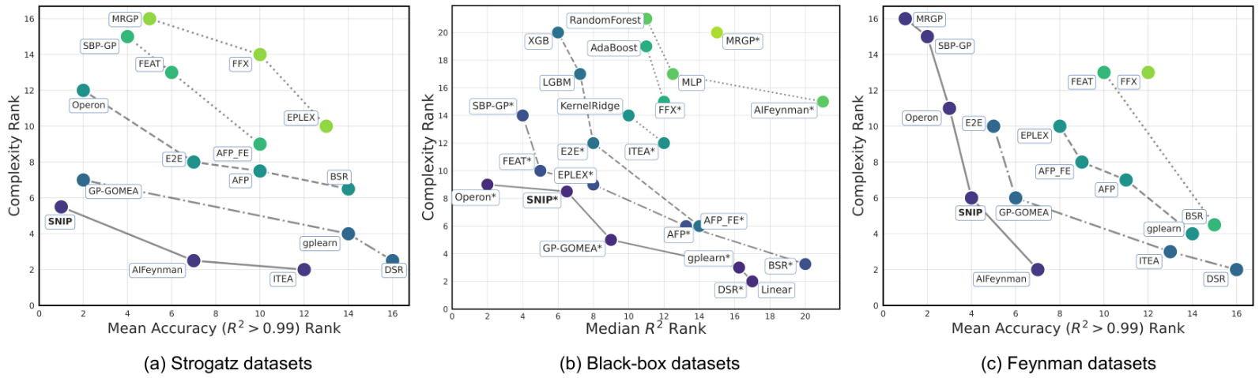
Evaluation

